Slide 1
Agriculture and Food Security in Urhoboland
By Malachy O. AKORODA
University of Ibadan, Ibadan

Slide 2
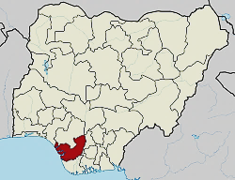
Delta State, Nigeria in 2021

Slide 3
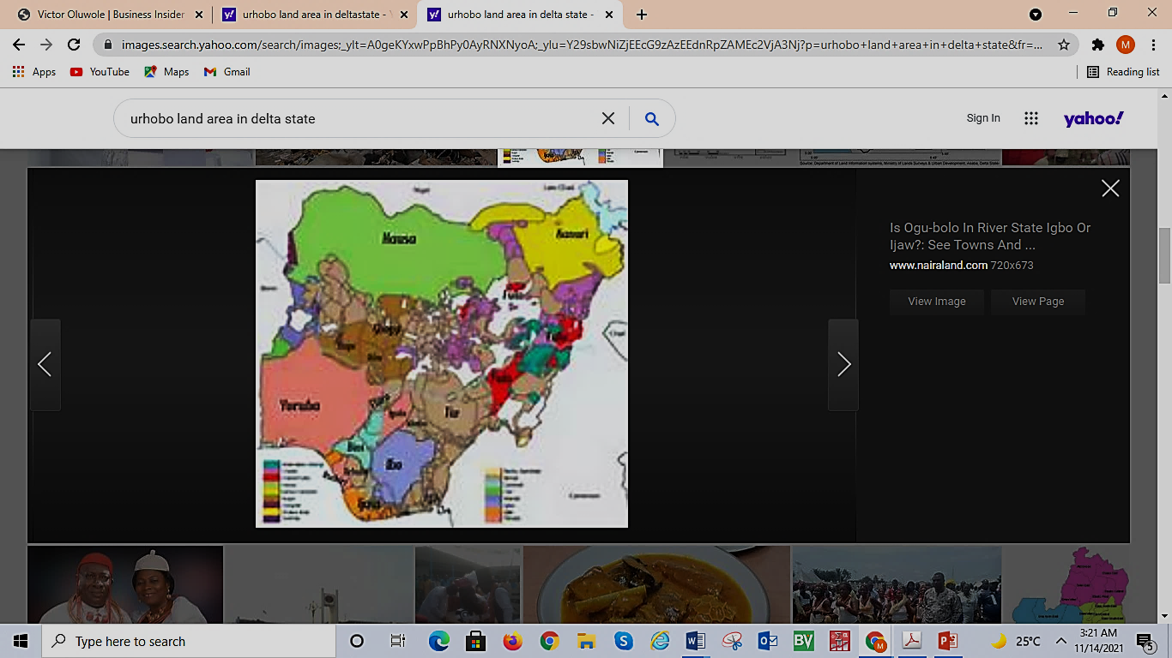
Ethnic groups in Nigeria = 364 according to Prof. Onigu Otite

Slide 4
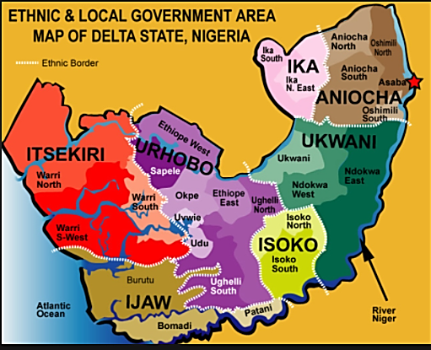
Urhobo is land-locked. So must collaborate
with all her neighbours
to be able to operate economically and sustainably. Aghware ye ihre.

Slide 5
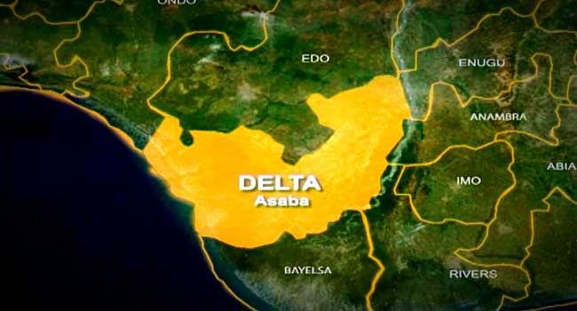
Urhobo neighbours

Slide 6
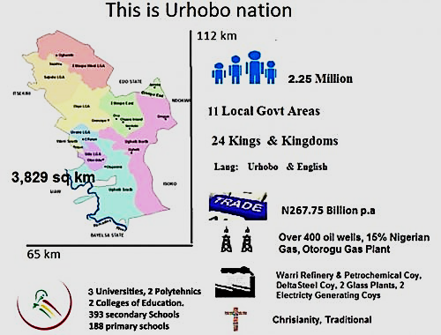
© Copyright Urhobo Economic & Investment Group. Website built by Maktay
Trinidad and Tobagp. The larger island is 105km long and 77km broad, an area 4,828 sq. km

Slide 7
Location and Size of Urhobo Nation
Urhobo Nation has a population of over 2.5 million people.
more people than in 8 states in Nigeria
More people in 75 countries in the world =
Equatorial Guinea,
Sao-Tome & Principe,
Comorros,
Seychelles
all Caribbean countries (except Cuba and Jamaica)
East Timor,
Papua New Guinea.

Slide 8
The State of Israel
7.4 million inhabitants of high diversity: Jews (80%) and Arabs (20%) and others.
Since 1948, the population increased 10-fold, due to immigration of Jews from round the world.
Today,
densely populated country
large regions are thinly populated.
young population (the median age is 28.3 years)
infant mortality rate is low (5.8 deaths/1,000 births)
life expectancy is high (78.7 years).

Slide 9
Trinidad and Tobago: 2004 Agric. Census
When shall we have Urhobo statistics for planning her development?
No stat., no plan, no growth, no development.
Total number of agric. holdings = 19,143 of which 18,169 or 94.9% in Trinidad and 974 or 5.1% in Tobago. A decline of 11,423 holders or 37.4% when compared 30,566 for 1982.
Total number of holdings in 2004 = 18,968. Most holdings were less than 10 hectares in area
Under 0.5 ha - 22 %
0.5 to < 1 ha - 12.8 %
1 to < 2 ha - 18.2 %
2 to < 10 ha - 8.9 %
10 to < 50 ha - 3.7 %
Over 50 ha - 0.3 %
Majority of holders (89.4%) in 6 areas.

Slide 10
Country Profile: Republic of Trinidad and Tobago
Capital: Port of Spain, Area: 5,128 sq km. Population: 1,226,383
(July 2012 est.) Life expectancy: 72 (2012 est.)
Pop. growth rate: - 0.086% (2012 est.) Languages: English (official),
Caribbean Hindustani (a dialect of Hindi), French, Spanish, Chinese
Inflation: 8.7% (2012 est.).GDP purchasing power parity: US$27.12 billion
(2012 est.) GDP per capita: US$20,400 (2012 est.) GDP composition by
sector: agriculture: 0.3%; industry: 58.8%; services: 40.8% (2012 est.) Land
use: arable land: 14.62%; tree crops: 9.16%; other: 76.22% (2005). Major
industries: petroleum and petroleum products, Liquefied natural gas,
methanol, ammonia, urea, steel products, beverages, food processing,
cement, cotton textiles. Agricultural products: cocoa, rice, citrus, coffee,
vegetables, poultry, sugar. Natural resources: petroleum, natural gas,
asphalt Exports: petroleum and petroleum products, liquefied natural gas,
methanol, ammonia, urea, steel products, beverages, cereal and cereal
products, sugar, cocoa, coffee, citrus fruit, vegetables, flowers. Export
partners: US 43.6%, Spain 5.1%, South Korea 4.8%, Jamaica 4.6% (2011)

Slide 11
LAND MASS AND RESOURCES OF THE URHOBO NATION
Contiguous 3,829 km2 territory of land and coastal areas
Cultural homogeneity
Home to many resources: 12 oil and gas fields; over 400+ oil wells, over 15% of the Nigerian natural gas reserves, and the largest Gas Plant, Utorogu Gas Plant in Sub-Saharan Africa at Otu-Jeremi
Mineral resources: Sand, Silica, Kaolin, Clay, Baryte
Forest resources: Timber, Oil palm and Raffia Palm
Abundant land for cropping and plantation agriculture
8 rivers with access to the Atlantic Ocean
Water bodies for aquaculture, recreation and tourism

Slide 12
Urhoboland Statistics
2 seaports at Warri and Sapele; 30 sites for river ports
1 airport at Osubi for local flights.
1 refinery, 1 petrochemical plant, Nigerian Gas Company, 1 steel plant, 1 Salt Refining Co., 1 world class wood processing plant, 2 glass making co., 2 gas-fired electricity gen plants at Ughelli, Sapele and other industrial clusters
10 LGAs, about 15 urban centers, 60 bank branches, 3 universities, 2 polytechnics and 2 Colleges of Education
1000 Govt Primary Schools, 250 Govt Secondary Schools
2000+ Churches, Mosques and Temples
abundant qualified manpower in any fields of endeavour.

Slide 13
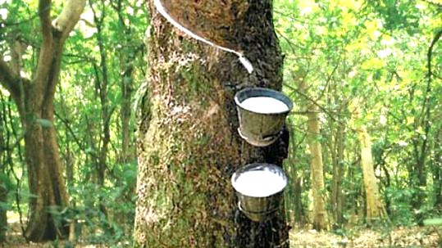
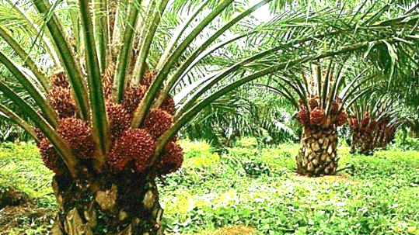
Rubber and Oil palm are two important crops to target for Urhoboland

Slide 14
Urhobo is endowed with a vast arable land of
about 4000 sq km. This land is suitable for the
cultivation of Cassava, Oil Palm, Raffia Palm,
Rice, Plantain, Banana, Yam, Sweet Potato,
Beans, Groundnuts, Coconut, Coco-yam,
Pepper, Melon, Mango, Orange, Paw-paw, Sugar
Cane, Pineapple, Alligator Pepper, Spices,
Bamboo, Timber, Rubber, etc. The Urhobo
environment has also been most conducive for
Poultry, Piggery, Grass-cutter
rearing, Rabbitery, Snailery and other forms of
animal husbandry. Fish farming is also a viable
agricultural enterprise thriving in Urhoboland.

Slide 15
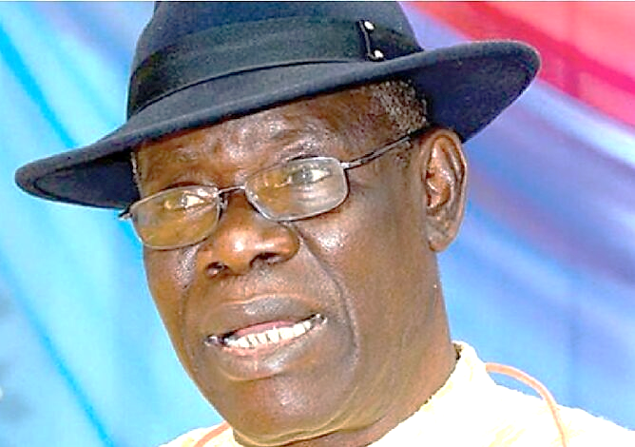
The Niger Delta people should encourage the northern food cabals to carry out their threat to stop food supply. That is when our politicians will realize that the business of governance is more serious than winning elections and riding in imported luxury jeeps.
Prof. G. G. Darah the Delta State Chairman of PANDEF

Slide 16
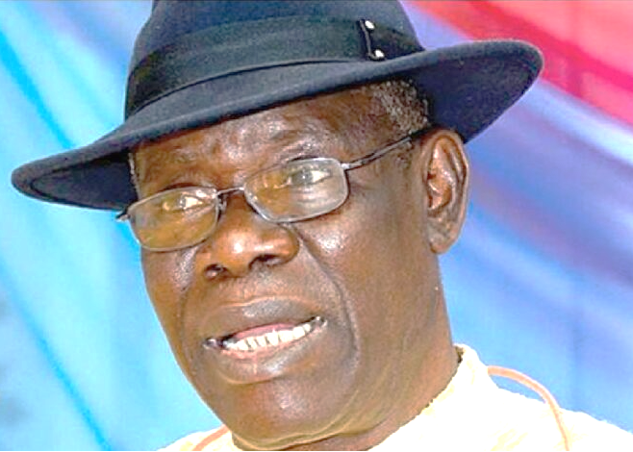
Niger Delta states are
in the Plantain and Banana belt
Much need for moisture
High in carbohydrates
All year cropping
Perennial crop
Tell them the story of Dr Ayuk-Takem & coolerful of boiled plantain in Yaounde Cameroon
Prof. G. G. Darah the Delta State Chairman of PANDEF

Slide 17
Food for All Urhobo: Solutions suggested
Own a garden around your homestead, bag, pots
Save all food before they are consumed
Feed others apart from your nuclear family
Plant food trees along all roads to share to all
Fund association and cooperatives of farmers
Diaspora Urhobo must support local activities
Eat balanced diet for all nutrients
Prepare food hygienically: do not overcook
Eat less oil, salt and sugars to keep fit
Serve only what is to be consumed: waste no food

Slide 18
“Ughwerun Kingdom of Urhobo leads in sweetpotato for chips consumed in hotels, restaurants and food joints across Nigeria.
Our rain forests are fertile for peppers and diverse spices

Slide 19
Activating Food Reserves for the Homeland
Egypt king asked Joseph how to avert famine
Joseph stored excess food in the good years
Joseph distributed food in the bad years
Who wants to be a Joseph for the Urhobo?
Does Urhobo have a food-bank or reserve?
Should there be any fall-back food supply?
Would manna not fall, if hunger spreads?
More hunger, more crime, at risk all of us.

Slide 20
Urhobo Diaspora can contribute to food supply
Urhobo Diaspora campaign and give resources:
to mechanize local agriculture through hiring units
to process of farm produce into intermediate/final products for sale in cities around Urhobo-land
to enhance the local farm transport system
Enhance Rural Road system besides road surfaces
Packaging manufacturing factory: good to do.
Warehousing infrastructure/food reserve needed.
Assist establish Cooperatives of food value chain

Slide 21
URHOBO UNITY SUMMIT
July 30 and 31, 2009
Conference Centre, Petroleum Training Institute, Effurun, Nigeria
--------------------------------------
Opening Session
Urhobo Bridge to the Neighbourhood
of the Niger Delta and Nigeria
A Welcome Address by Olorogun Felix Ibru
President General, Urhobo Progress Union

Slide 22
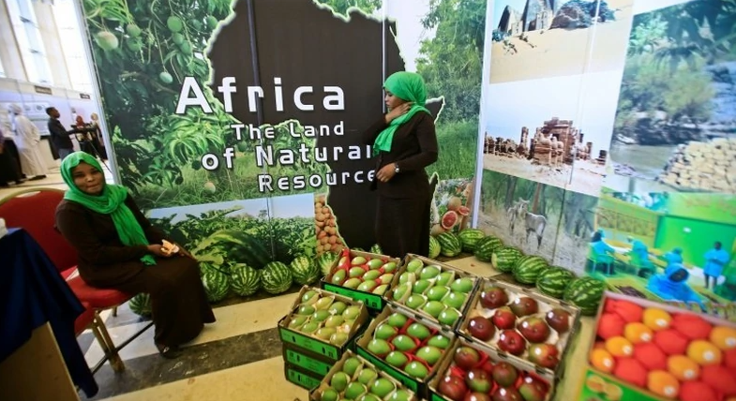
Until our products at fairs are packaged to attract and uniformly conform to standards, we shall sell rubbish

Slide 23
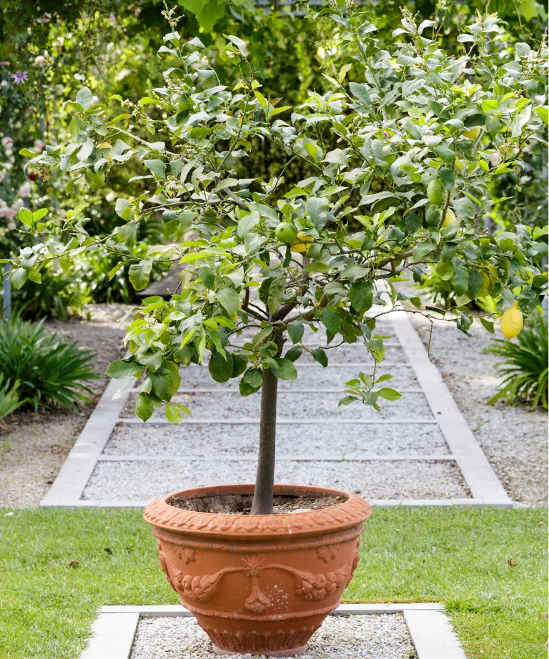
A tree in a pot.
This is the way to grow many fruits in containers
in small spaces around the house in city as well as
in rural areas.
Spot the fruit at the lowest point of tree

Slide 24

Late Professor Peter Palmer Ekeh

Slide 25

Note-book and Pencil: The art of record-keeping
NOT ONLY RECORDS OF MONEY
Dates / Places
Names / Addresses
Time of Purchases / Inputs
People met/ Places visited
Key agreements / Advice received
Plan for today and tomorrow

Slide 26
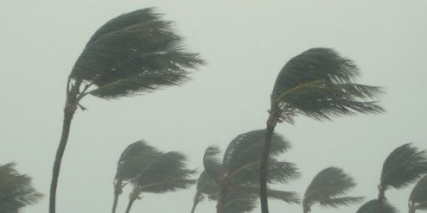
Rain storms destroy farms,
so we need insurance to cover the efforts of the people along the food value chain that supplies Urhobos.

Slide 27
Every Urhobo LGA can produce a food product for food for family and also for sale.
So let each LGA specialize on handling that crop food item by producing it most efficiently.
Then, adequately transform or process such crop applying the best standard procedures and expect food and income within and outside Urhobo-land.

Slide 28
Urhobo-land has Rainforest and Freshwater swamp vegetations.
So we must specialize on tree planting
I suggest MILLIONS OF TREES be planted in all villages so that an effective cooperative can be formed as a marketing board that
would collect, process, and market the produce to Asaba, Warri, and Benin at least.

Slide 29
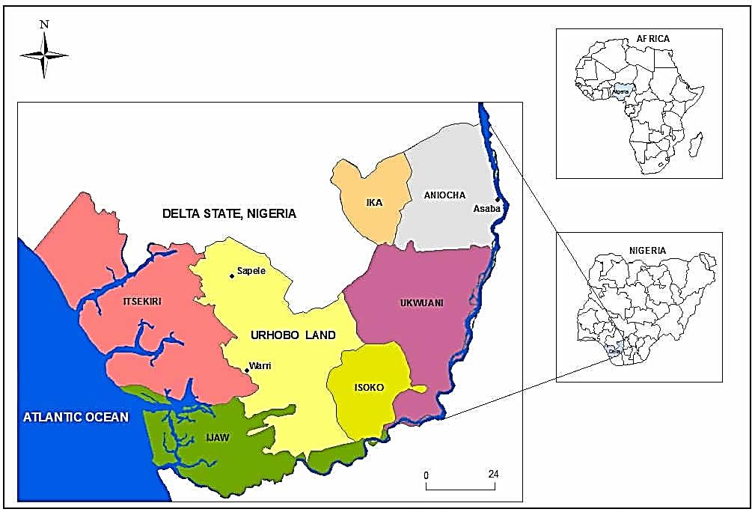
Urhoboland in Delta State and 5 neighbours
M
About 4000 sq km
Central Hinterland
Km

Slide 30
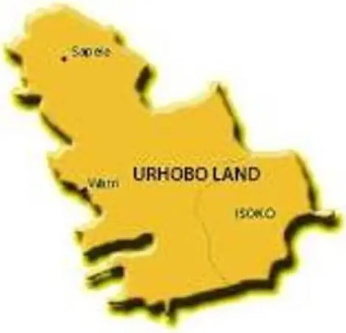
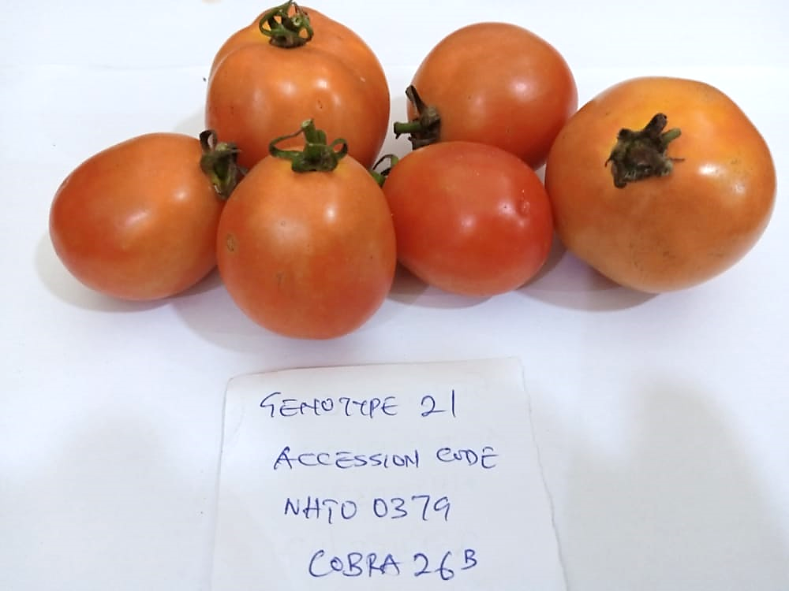
Items for cooking food in Urhoboland
Die Urhobo vwo cher’ emu?

Slide 31
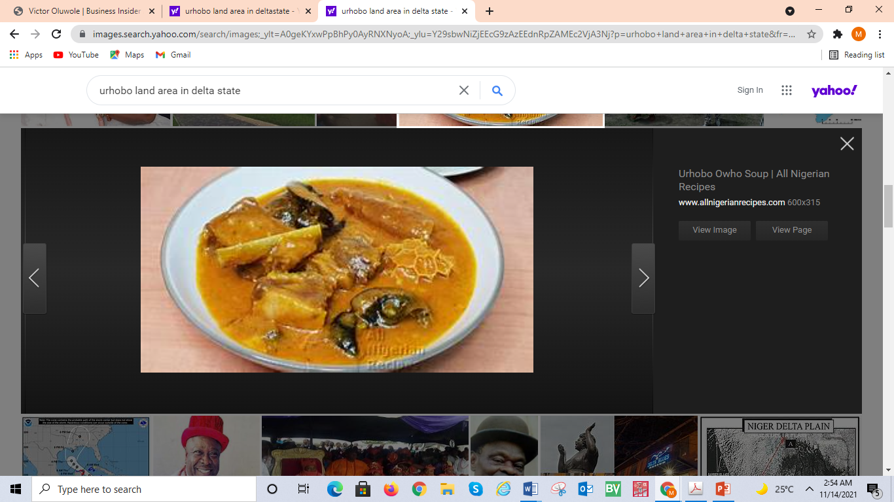
Die
wọ mrҿ vwҿ evrҿ oghwo na?

Slide 32
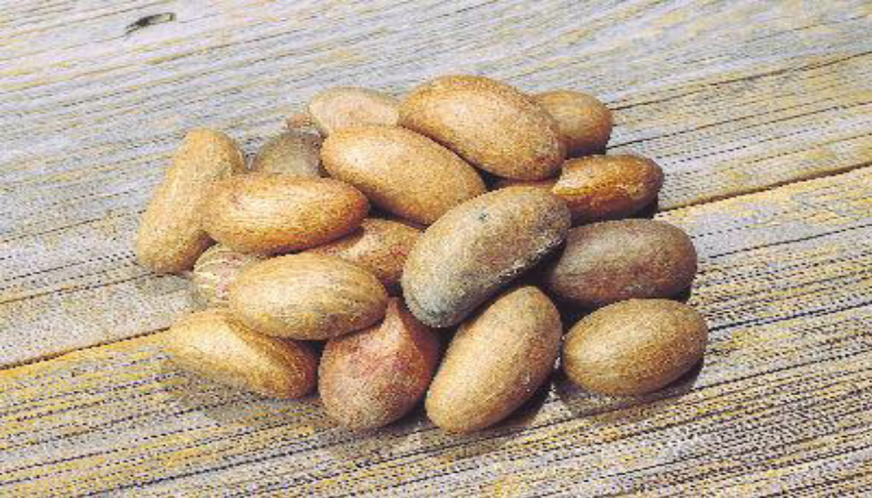
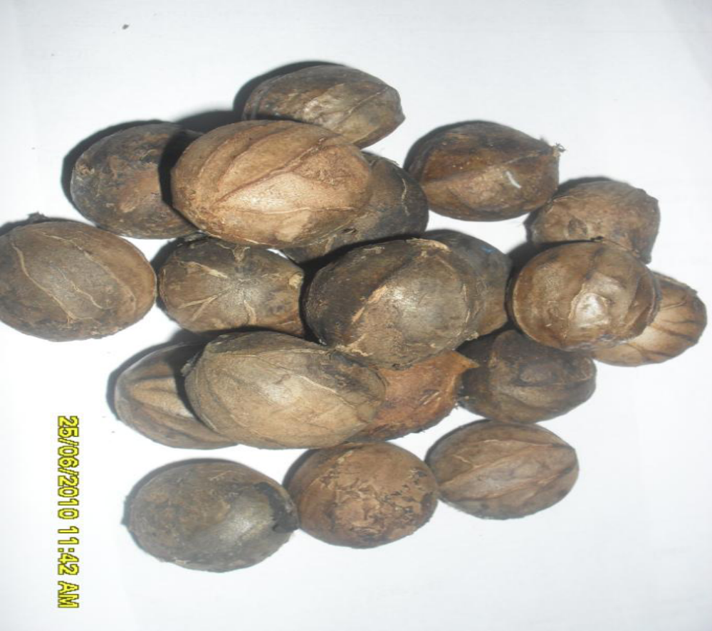
Garcinia kola
(Bitter kola)
Pluckennetia conophora
(African walnut)

Slide 33
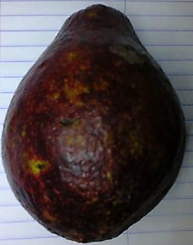
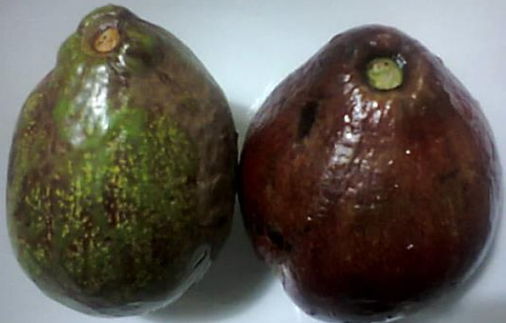
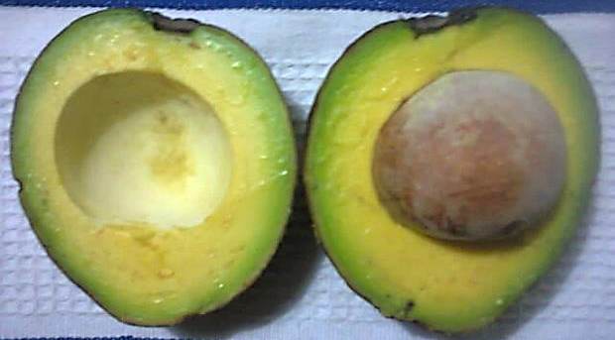
AVOCADO: is a neglected nutritious money earner that Urhobo can produce
Plant a tree in your home compound and harvest over 1000 fruits and could be sold across many urban areas

Slide 34
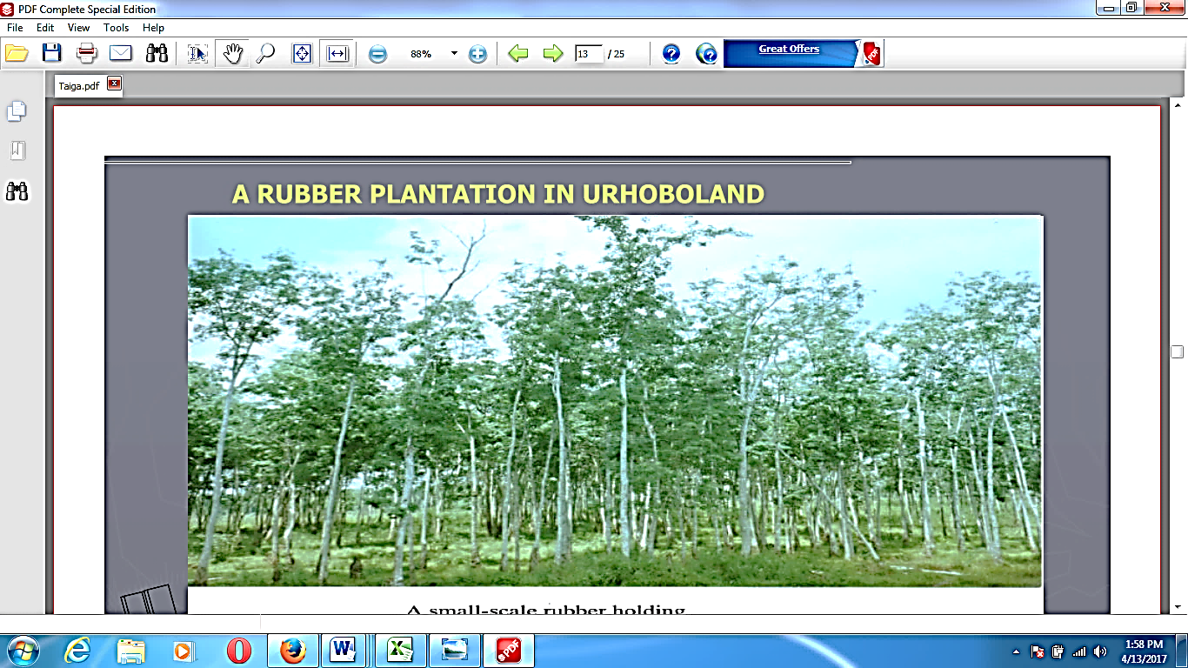
Rubber Industries in Urhoboland for shoes and products is viable

Slide 35
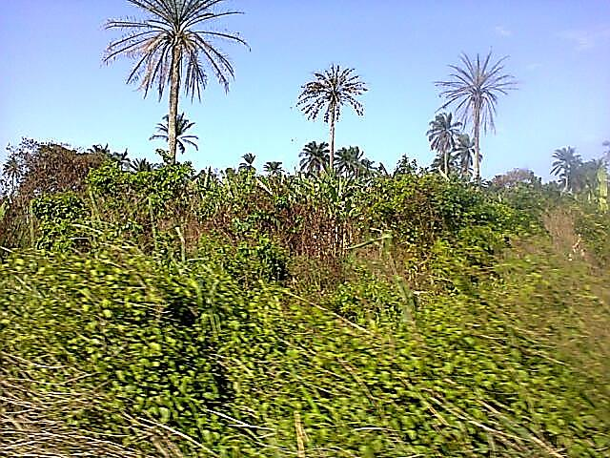
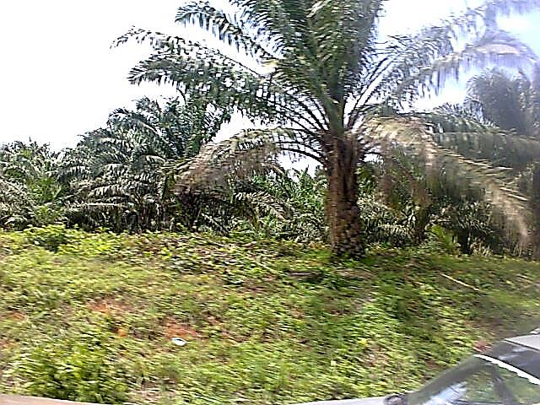
Skyline in Urhoboland
showing wild oil palms and
new breed of oil palm trees inter-planted with cassava

Slide 36
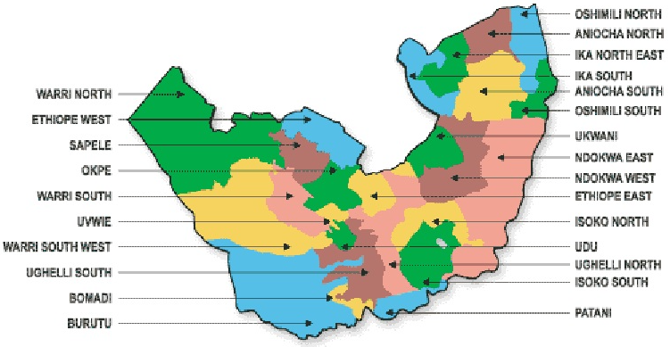
Produce and trade with neighbours
Local governments of Delta State and Urhobo in the centre

Slide 38
Declining Budget to Agriculture in Delta State
Annual Budget Share to agriculture in Delta State is far too small
Year Percent
2013 2.40
2014 1.20
2015 3.25
2016 0.59
2017 0.45
Average 1.58
The low share in 2017 is worrisome knowing the importance of the sector to the economy even in the current period of recession
Ethnic and LGA authorities must look inward and take responsibility to ward off impending hunger even if there is cash. Not enough local food output and modern knowledge of healthier diet is a matter for urgent food extension.

Slide 39
Who eats what we produce, if we can produce?
Sale outlets well-mapped to cover buyers along routes within and from Urhobo-land and radially focus on ALL towns of the SE, SW, and SS states.

Slide 40
52 major economic food crops grown in Urhoboland
Sugar crop [1]: Sugarcane. Cereals [2]: Maize, Rice
Root & Tubers [6]: Cassava, Yellow yam, white yam, water yam, Cocoyam, Sweetpotato. Oil crops [9]: Groundnut, Oil palm, Coconut, Melon. Pulses [1]: Cowpea = icha/iree
Fruits [17]: Plantain, banana, Citrus [orange [utiẹn], lemon, grapefruit, lime [utiẹn-eni], tangerine, shaddock], Pawpaw, Avocado, Pineapple, Guava, Mango, African Star apple (C. albidum), Ogbono (owe) , Ube [D. edulis], Soursop, raphia, pepperfruit, oruru=otiti (Maesobotrya barteri).
Vegetables [15]: Amaranth, peppers, ocimum, tomato, Telfairia [umẹẹ], bitter leaf, celosia, corchorus, eggplant, pumpkin, carrot, watermelon, okra, cabbage, green beans, lettuce, cucumber.

Slide 41
State in Nigeria | Land area (km2) | NPC 2006 population | Persons/ km2
Abia | 4,877 | 2,833,990 | 581.1
Akwa ibom | 6,806 | 3,920,208 | 576.0
Bayelsa | 11,007 | 1,703,358 | 154.8
Cross River | 21,930 | 2,888,966 | 131.7
Delta | 17,163 | 4,098,391 | 238.8
Edo | 19,698 | 3,218,332 | 163.4
Imo | 5,165 | 3,934,899 | 761.8
Ondo | 15,086 | 3,441,014 | 228.1
Rivers | 10,378 | 5,185,420 | 499.7
Total | 112,110 | 31,224,587 | 278.5
Enough land in Delta State. Urhobo land occupies a third-part of Delta State has enough land to do TREE-BASED agriculture. That is our comparative advantage.

Slide 42
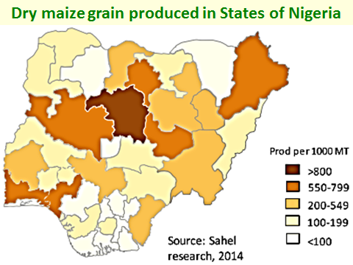
Urhobo-land is too wet to get a good dry maize yield but
we do roast fresh cobs as food in the season of harvest

Slide 43
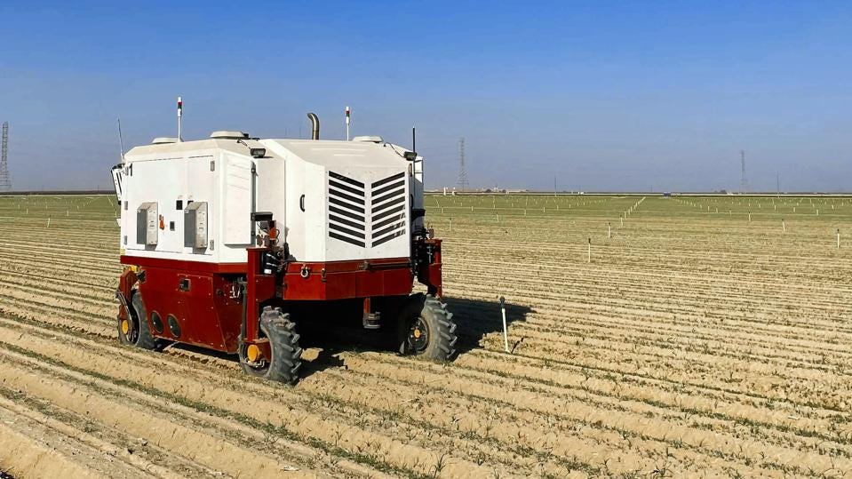
A Carbon Robotics autonomous laser-weeder in a farmer's field.

Slide 44
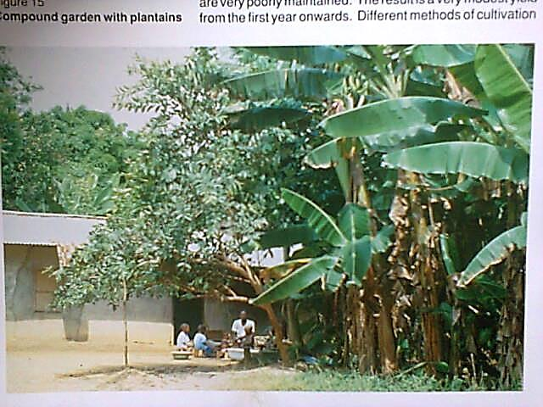
Compound gardens as a sustainable reliable food source for severally employed families

Slide 45
Percent of income generating activities of 160 farmers in Iwo & Odo-Otin LGAs, Osun State, Nigeria before and after 10 years of climate change.
Source: Akinbile (2010)
 | Activity | Before | Now | % Change
1 | Sweetpotato | 58.125 | 91.250 | 33.125
2 | Trading | 31.875 | 50.000 | 18.125
3 | Goat rearing | 46.875 | 52.500 | 5.625
4 | Maize | 93.125 | 98.125 | 5.000
5 | Fruit collecting | 58.750 | 62.500 | 3.750
6 | Food processing | 63.125 | 66.250 | 3.125
7 | Cassava | 85.625 | 88.125 | 2.500
8 | Yam | 88.125 | 88.125 | 0.000
9 | Rabbitery | 1.875 | 1.875 | 0.000
10 | Piggery rearing | 1.875 | 1.250 | -0.625
11 | Artisan | 6.250 | 5.625 | -0.625
12 | Sheep rearing | 10.000 | 8.125 | -1.875
13 | Fishing | 5.625 | 3.125 | -2.500
14 | Food vendoring | 8.750 | 5.625 | -3.125
15 | Craft/Basket weaving | 17.500 | 14.375 | -3.125
16 | Hired labour | 5.625 | 0.625 | -5.000
17 | Lumbering | 7.500 | 0.000 | -7.500
18 | Hunting | 31.250 | 15.625 | -15.625
19 | Poultry rearing | 46.875 | 28.125 | -18.750
20 | Snail collecting | 36.250 | 17.500 | -18.750
21 | Kola | 61.250 | 39.375 | -21.875
22 | Cocoa | 56.250 | 32.500 | -23.750
23 | Selling firewood | 46.875 | 17.500 | -29.375

Slide 46
Well-Packaged Urhobo Specialty Foods
Ukodo: Pottage of yam/unripe plantain/cocoyam with palm oil, leaves, spices and crayfish especially ekaka.
Kpokpogari: more fibre, less starch. Eat with dryfish, ọdọn, peanuts. Ikpakho: Boiled & roasted over heath for a fermented taste. Usi: Cassava starch from grated roots squeezed through fine sac-cloth. Stirred in suspension in pot over low heat with drops of palm oil until a hard gel forms.

Slide 47
Well-Packaged Urhobo Specialty Foods
Banga soup (Amiedi). Soup made from slurry squeezed from mesocarp of oil palm fruits, well spiced and sweetened with crayfish and dry or wet fresh fish. Usually eaten with gari paste or usi. Egun: Pounded paste of usi and boiled ripe plantain or gari. Oghwo. Palm oil soup with ughwerin or kaun with vegetable spices. Thickened with starch or gari. Ọdọn: Larva in rotted stem of oil palm. Roasted for sale. oily protein.

Slide 48
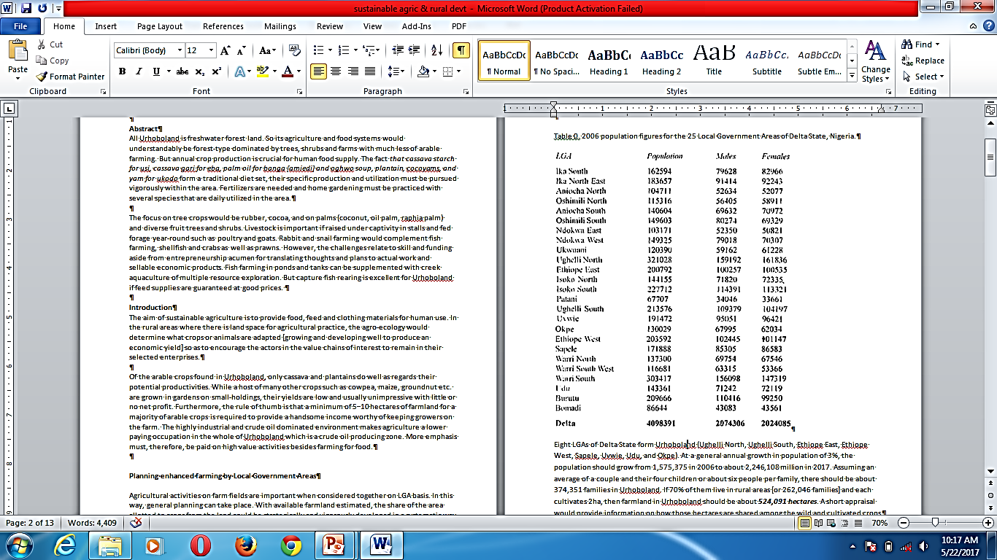
Human population of 25 LGAs of Delta State in 2006
8 LGAs form Urhoboland: Okpe, Ughelli N, Ughelli S, Ethiope E, Ethiope W, Sapele, Uvwie, & Udu
In 8 LGAs, at 3% population growth, 1,575,375 Urhobo in 2006 census rose to 2,528,014 in 2021. At 6 persons/family, we have 421,336 families.
If 70% of them live in rural areas [=294,935 families] and if each farms 1.5 ha, so Urhobo farm area could be
400,000 hectares

Slide 49
Fish and Prawn Industry in Urhoboland
Creeks and inland waterways can be used to farm fish and prawns. Artificial fish protection and production is a good industry for fish for humans.
Creeks and swamps are highly productive and help diversify occupations for farmers and craftsmen in the community.
Submerged cages in waters of rivers and ponds with added feed will bring a good supply of fish and aquatic livestock for fresh and dry protein supply.

Slide 50
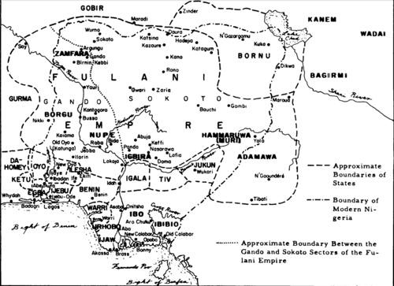
19th-century map of Nigeria; the Urhobo are marked "IRHOBO".

Slide 51
Pharmacopoeia: Research and Production of Herbals
Both research and production must take place together.
Many local herbalists need to be integrated and their claims and recommendations tested for effectiveness.
Alternative medicine can thrive better than the current approach involving uncontrolled sales and usage.
Growing and processing of medicinal plants is good for Urhobo Nigeria.

Slide 52
China produces and exports so much herbal medicines worldwide for human use.
Skill, expertise, and investments would be well rewarded in a short time interval.
Health preservation is a first factor in any human life. As orthodox medicine and herbal medicine are attend to different illness unequally.

Slide 53
One million trees in Urhobo-land: materials to setup and operate seedling nurseries for 3 years in 10 locations [26 Jan. 2020]
 | Expenses (general or per each of the 10 locations) | No. |  | Price (Naira) | Cost (million Naira) | Cost in US$ at N360/$ | % of total
1 | Seedlings/grafts/seeds | 1,000,000 |  | 43 | 43.00 | 119444 | 59.9
2 | Poly bags/pots | 1,000,000 |  | 5 | 5.00 | 13889 | 7.0
3 | 3 Labour each x 33 months | 990 |  | 10,000 | 9.90 | 27500 | 13.8
4 | Pump for bore hole | 10 |  | 75,000 | 0.75 | 2083 | 1.1
5 | Bore hole (1 each) | 10 |  | 550000 | 5.50 | 15278 | 7.7
 | 32 other budgeted items |  |  |  |  |  | 10.6
38 | Sub-total of costs (ST) | - | - | - | 67.10 | 186305 | 93.5
39 | Contingencies: 2.5% ST |  |  |  | 1.68 | 4658 | 2.3
40 | Admin. & Coordination: 4.5% ST | - | - | - | 3.02 | 8384 | 4.2
41 | Grand total of costs | - | - | - | 71.76 | 199346 | 100.0

Slide 54
14 December 2020
Urhobo Leaders Brainstorm On Harnessing
Agricultural Potential In Urhobo Land
Prominent Urhobo leaders, yesterday, met in Asaba, the Delta State capital to review and harness the agricultural potential in Urhobo land with a view to creating employment and reducing poverty in its 24 kingdoms.
The leaders, who stated this at the third edition of Urhobo Economic and Investment Summit, said subsistence farming was no longer fashionable and could not create the desired economic prosperity in the state.

Slide 55
Everyman to Himself is Approaching
Today’s youth [15 to 35 years] though in majority are unable to understand where the current of life is flowing. Neither can they comprehend it.
Federal Government spends only 1.3% of Budget on agriculture; an average of 1.58% by Delta State. So each state is to cater for herself and the future of food and healthy diets for the Urhobo is dull and dark. Worldwide, Food comes first, not dress or show or self pride.
Are Urhobos wise? Then, they must begin to PLAN AND ACT to escape the pending trap of emigration and death for those who cannot leave Urhoboland.

Slide 56
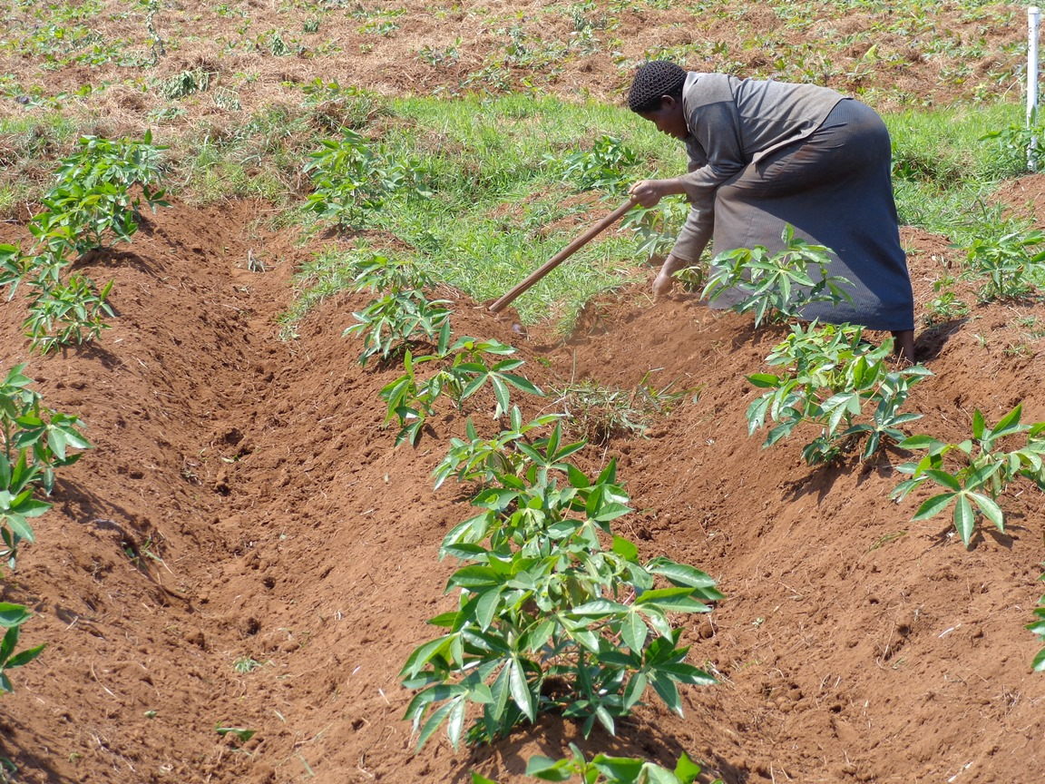
Hand hoe weeding of cassava fields is too ineffective to control weeds in large farms: combine
this with appropriate herbicides
The current manual farm methods do not provide enough household food, more so to sell to market.

Slide 57
Urhobo Food Fund: Essential for Averting Ethnic Hunger
Free seedlings to one million compounds each season
Training flyers and advice point developed
No cash given to any family anywhere besides a progressive accumulative annual tree planting
Dispersed nurseries to raise seedlings of chosen crops
Agree on a set of essential trees for food and materials and sale as well as a massive planting of tree and shrubs on all community spaces
Better food nutrition knowledge to all in Urhoboland
Concept note developed and shared to Urhobo societies and associations in Nigeria and Diaspora

Slide 58
How to Boil Naira Notes for Food
Assuming we shall always get food to buy locally
Assuming many families will get enough money to feed right and stay well in the community
Wasting or allowing land to lie fallow and not amending soil fertility across the land timely
Thinking Urhobo traditional foods need no adjustments or shifts in proportions of usage
Preserving or neglecting the knowledge gap regarding healthier diet among our people
Forgetting to maintain the united-ness of Urhobos at home and abroad at LGA basis
Make no decision, and take no action; be silent

Slide 59
Urhobo Food Fund: Essential for Averting Ethnic Hunger
The ability to manage food crops that are produced annually and permanent crops that yield fruits each year helps to assure sustainable food for home and markets.
To cope with climate change requires farmers shift among food and cash crops.
Urhobo can industrialize cassava and its products for sale in Nigeria and to Urhobos in diaspora.
An Urhobo food fund is needed to translate words, wishes, plans and visions into reality through action steps steadfastly implemented over time consistently.

Slide 60
Economics of Cassava Production using Appropriate Herbicides in Oyo State, Nigeria (in Naira/hectare)
Movon + Long handle hoe | Variable costs/ha | 189,227.62
 | Revenue/ha | 367,016.67
 | Gross margin/ha | 177,789.05
 | Net profit | 174,289.00
Movon + Maister 61 WG | Variable costs/ha | 199,076.54
 | Revenue/ha | 391,680.58
 | Gross margin/ha | 192,604.04
 | Net profit | 189,104.00
Movon + Maister Power | Variable costs/ha | 199,258.72
 | Revenue/ha | 399,283.40
 | Gross margin/ha | 200,024.68
 | Net profit | 196,525.00
The greater profit comes from processing cassava into products with more cash value such as: starch, gari or ethanol

Slide 61
Oja’kọna. Urhobo jee nyo ghware-ọ
In the future, our inaction will imply that each and every nation and community will have to feed themselves
Can Urhobo feed herself without the work of other ethnic nations or shall we die of hunger as is now happening in parts of Nigeria, Malawi, Somali, or other African nations?
Urhobo kpare obọ nonẹ…isẹ

Slide 62
Total use and industrialization of Oil palm
Leaf lamina
Leaf midrib
Leaflet broom
Fruit mesocarp
Kernel
Nut shell
Tree Stem
Roots
Industry set to create end products
Pomade
Margarine
Perfume base
Food oil
Edible worm
Wine

Slide 63
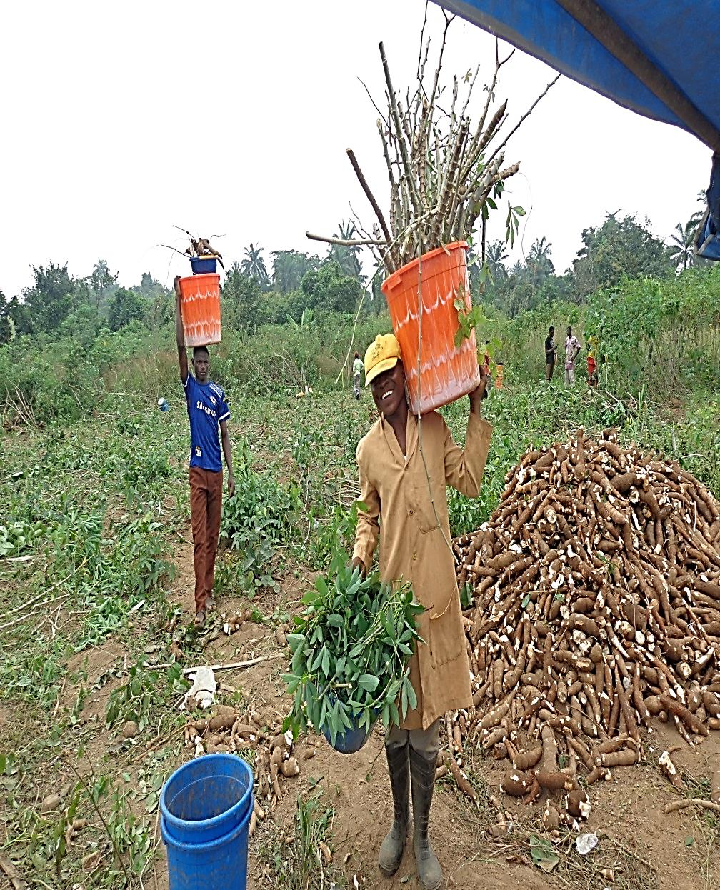
Building an industry based on a total harvest of all five products from cassava fields—
storage roots, plantable stems, stem stumps, stem twigs and leaves

Slide 64
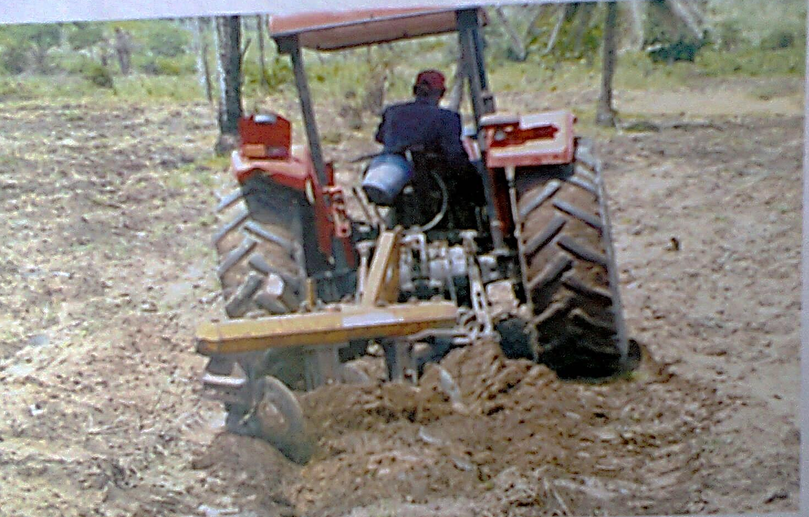
World over, the tractor is king of big farm work, for pulling many attached equipment

Slide 65
Urhobo Agro-Economic Summit
A committee of the willing, informed,
knowledgeable and capable: Show me your CV
Working on a measurable progress: QQT
Chart of work and timeline: QQT
Funds with multiple signatories: Budgets
Search for commitment = TRUST AND CONCERN

Slide 66
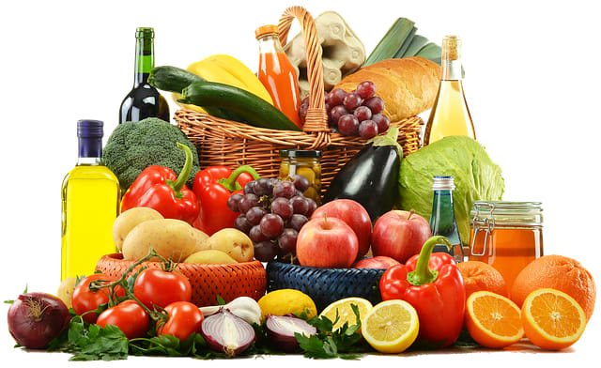
Produce, Process, Store well, Use right

Slide 67


Fully engage the youths in enterprises in the food chains so that food security and community peace can be greatly enhanced without migration or moving them out of their locations.

Slide 68
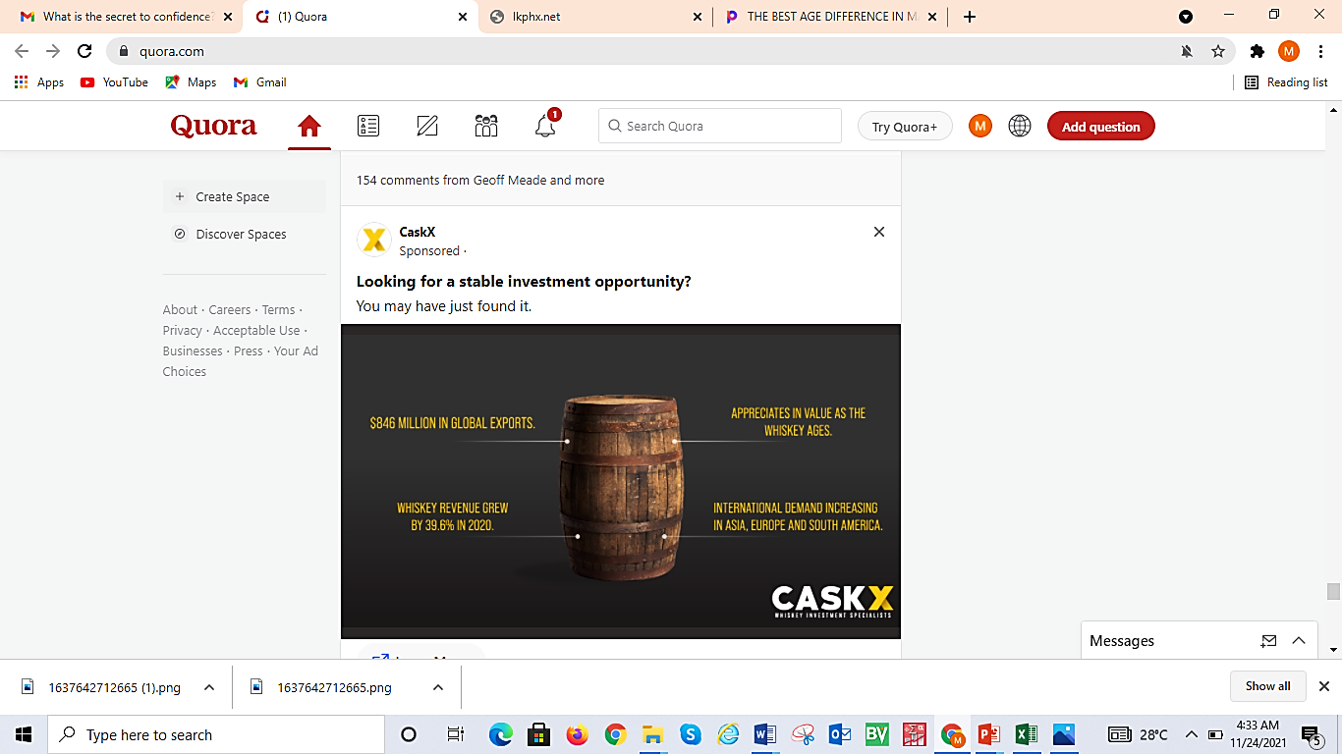
Idjagodo of whiskey gin

Slide 69
Produce, process and package the little we plan to preserve for long periods to assure food supply to the community.

Slide 70

Team = together each achieves more

Slide 71
Not a joke but an appeal
To all Urhobo in Nigeria and abroad
If you love Urhoboland and wish for its progress through better agriculture and food supply interventions
Then send text to me at 08035829286 of your willingness to spend N1 million each to initiate planting millions of trees across Urhoboland within one week.

Slide 72
Grateful to UHS & the Organisers
for inviting me to give this Lecture
Thank You All For Listening
Owa ko bi ruo.
Mi ye re agware

